Slide 1
At Last!, The Solution to the Turbulence Problem
Carl H. Gibson
Departments of MAE and SIO, CASS, UCSD, La Jolla CA 92093-0411,
cgibson@ucsd.edu,
http://sdcc3.ucsd.edu/~ir118
AAAS turbulence meeting San Diego 15 June 2016
Notes:
4:25 to 5 pm in Room E

Slide 2
Catastrophic Equatorial Icing

Slide 3
Turbulence Problem Solved!

Slide 4
Extreme Equatorial Icing

Slide 5
What happened to AF 447?

Slide 6
Four Minutes Left to Live

Slide 7
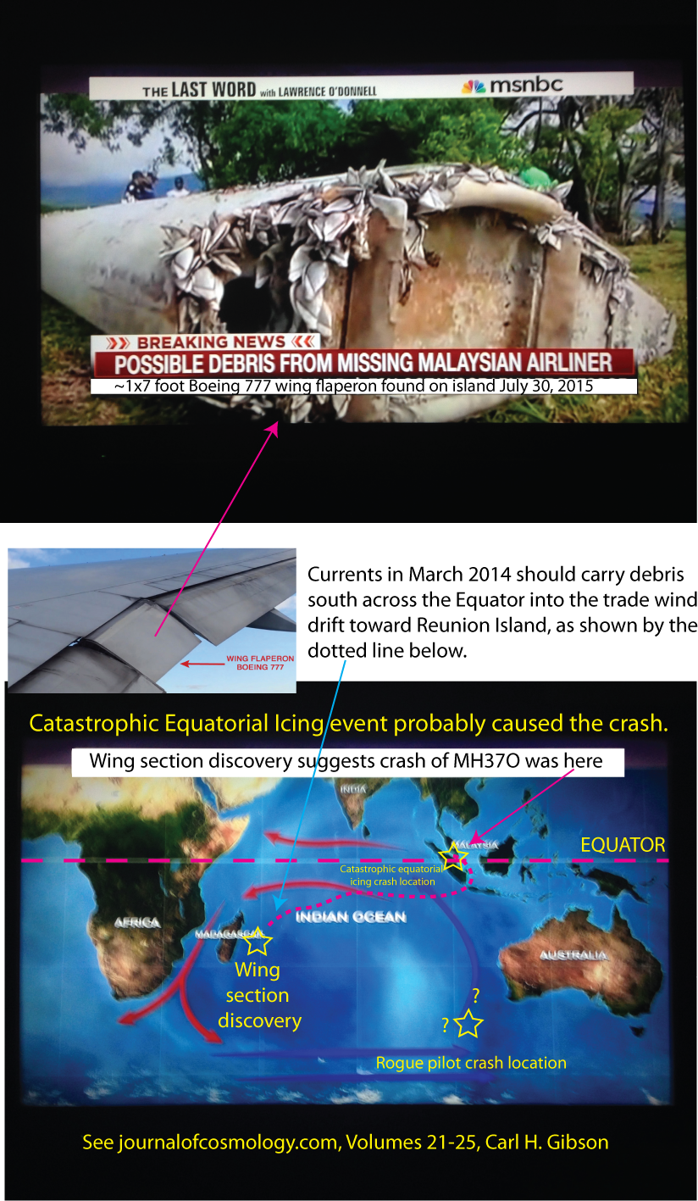
Mystery Airplane Crash

Slide 8
Where is MH 370?
Rogue Pilots are holding it hostage
Rogue Pilots crashed it near Perth
It crashed in the South Indian Ocean
It crashed where it was last seen
It was captured by aliens

Slide 9
What happened to MH 370?

Slide 10
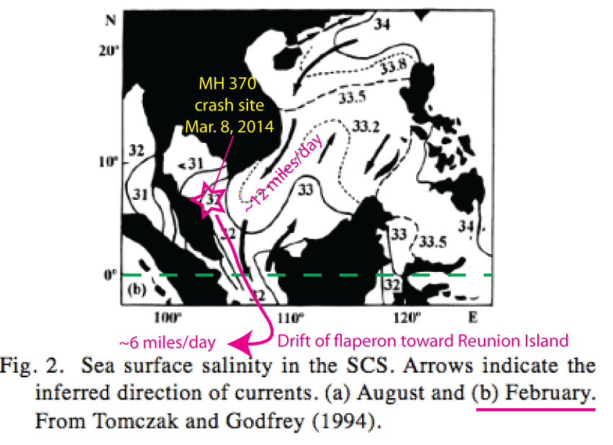
What were the currents?

Slide 11
What happened to MH 370?

Slide 12
Rogue Pilots Went South

Slide 13
Definitions of turbulence and fossil turbulence and the direction of the turbulence cascade
Fossil turbulence waves allow seals to survive dark polar winters
Turbulence ALWAYS cascades from small scales to large

Slide 14
Turbulent Length Scales

Slide 15
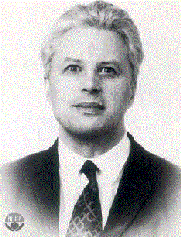
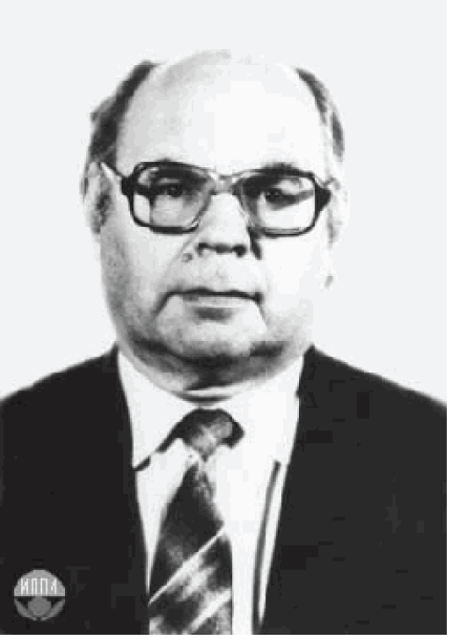
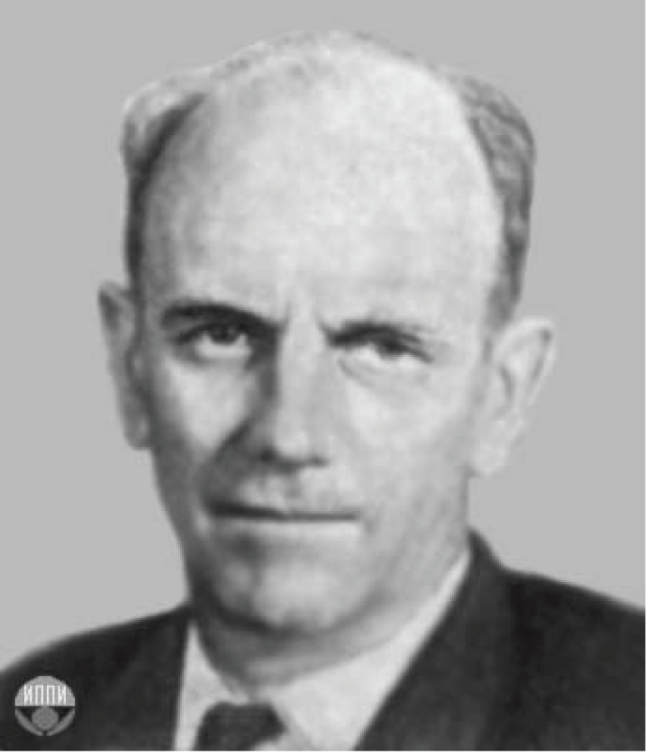
Critical Turbulence Length Scales

Slide 16
Fossil Turbulence Scales

Slide 17
Nomura Scale Pancakes Make 10^20 m Spaghetti

Slide 18
Crash of QZ8501

Slide 19
Extreme Intermittency of Catastrophic Equatorial Icing

Slide 20
QZ8501 Summary

Slide 21
Conclusions
New turbulence is an eddy like state of fluid motion where the inertial vortex forces of the eddies are larger than any other forces that tend to damp the eddies out.
New turbulence always cascades from small scales to large.
New turbulence and the universal similarity laws of Kolmogorov apply for all length and time scales observed, from Planck to cosmological scales.

