Slide 1
Catastrophic Equatorial Icing Events May Be Crashing Airplanes
Carl H. Gibson
Departments of MAE and SIO, CASS, UCSD, La Jolla CA 92093-0411,
cgibson@ucsd.edu,
http://sdcc3.ucsd.edu/~ir118
AOS seminar, Oct. 1, 2015, Spiess 330, 4 pm
Notes:
AOS Seminar Oct. 1, 2015, Spiess 330, 4 pm

Slide 2
Catastrophic Equatorial Icing

Slide 3
Extreme Equatorial Icing

Slide 4
Beamed Zombie Turbulence Maser Action Mixing Chimneys
Generic mechanism for vertical and radial transport in natural fluids
Ocean, atmosphere, galaxy, stars
Heat, mass, momentum, information
Supercooled water vapor of Catastrophic Equatorial Icing
Journalofcosmology.com vol 21

Slide 5
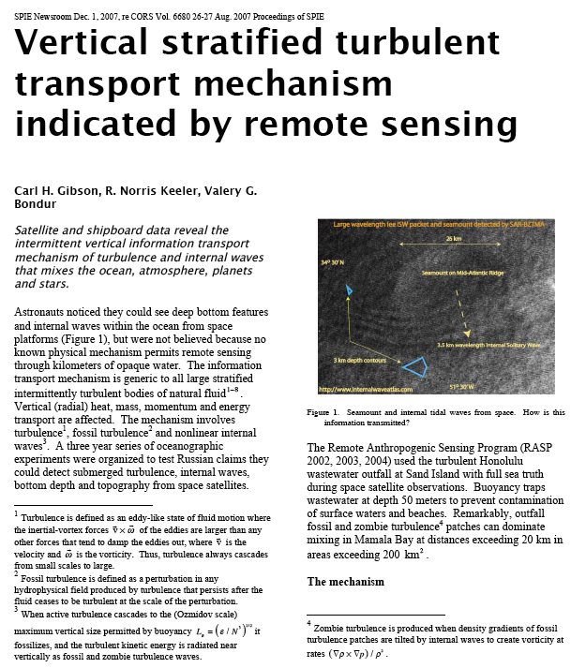
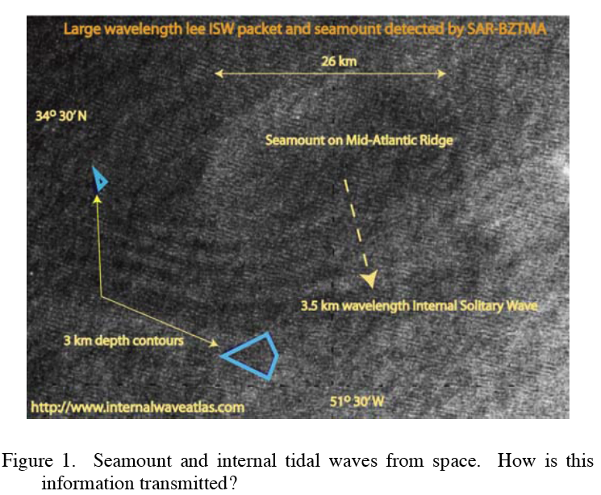
Answer:
Beamed Zombie Turbulence Maser Action (BZTMA) Mixing Chimneys

Slide 6
What happened to AF 447?

Slide 7
Four Minutes Left to Live

Slide 8
Crash of QZ8501

Slide 9
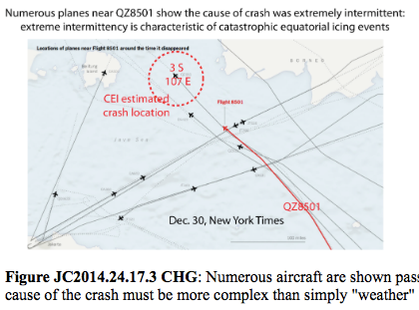
Planes don’t just crash!

Slide 10
The Last Four Minutes

Slide 11
Where does icing occur?

Slide 12
Where is MH 370?
Rogue Pilots are holding it hostage
Rogue Pilots crashed it near Perth
It crashed in the South Indian Ocean
It crashed where it was last seen
It was captured by aliens

Slide 13
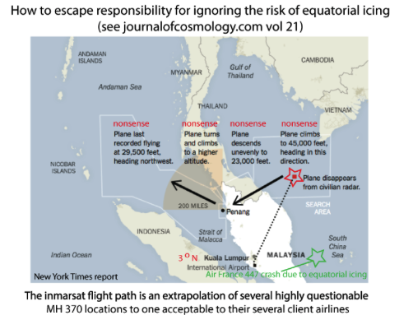
Rogue Pilot Theory

Slide 14
Rogue Pilot Speculations

Slide 15
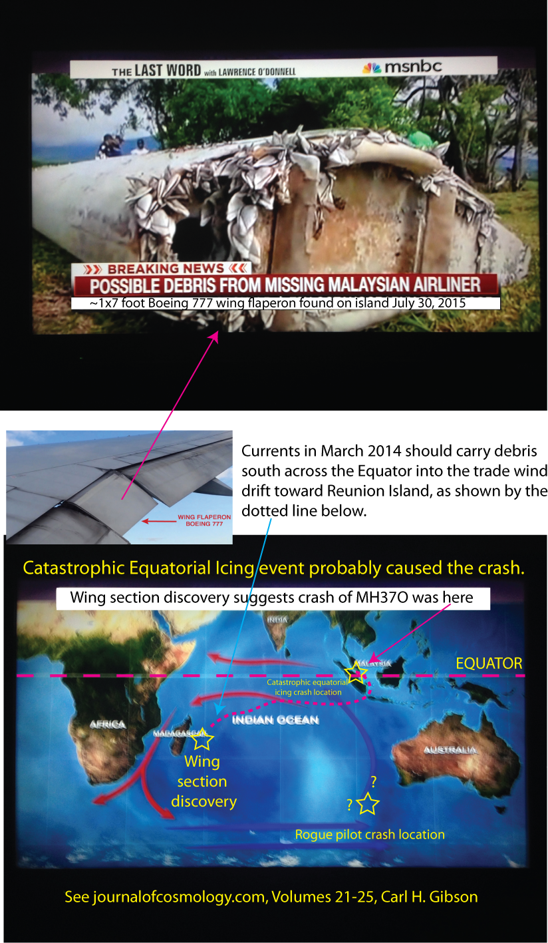
Mystery Airplane Crash

Slide 16
What happened to MH 370?

Slide 17
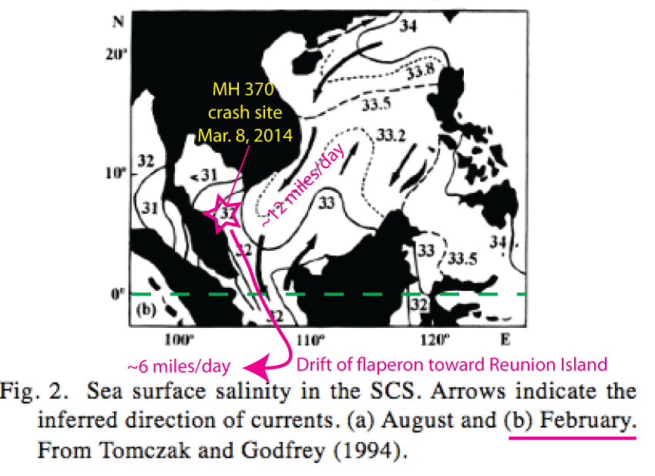
What were the currents?

Slide 18
What happened to MH 370?

Slide 19
Rogue Pilots Went South

Slide 20
Turbulence Problem Solved!

Slide 21
Definitions of turbulence and fossil turbulence and the direction of the turbulence cascade
Fossil turbulence waves allow seals to survive dark polar winters
Turbulence ALWAYS cascades from small scales to large

Slide 22
Credit to postdoctoral scholars

Slide 23
Fossil Turbulence Scales

Slide 24
CMB Velocities Show Weak Plasma Turbulence

Slide 25
Nomura Scale Pancakes Make 10^20 m Spaghetti

Slide 26
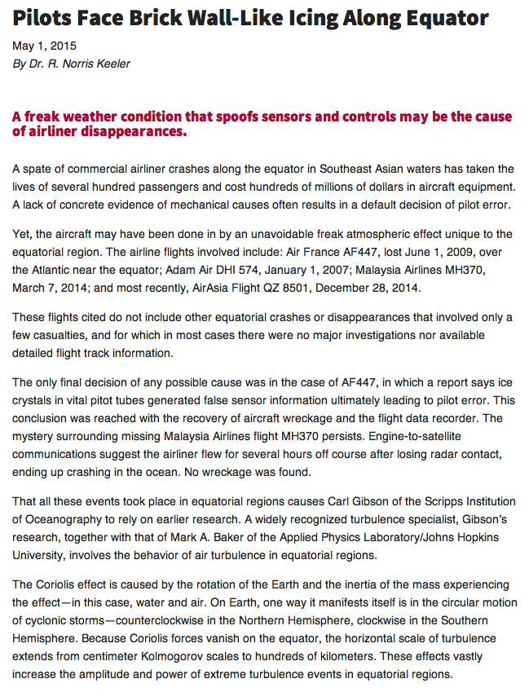
Keeler article May 1, 2015

Slide 27
Conclusions
Catastrophic equatorial icing is crashing airplanes near Indonesia
The cause of equatorial icing is extreme turbulence intermittency at the equator, plus BZTMA mixing chimneys of supercooled equatorial steam
MH 370 flaperon arrival at Reunion disproves Rogue Pilot speculations.

Slide 28
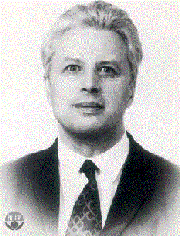
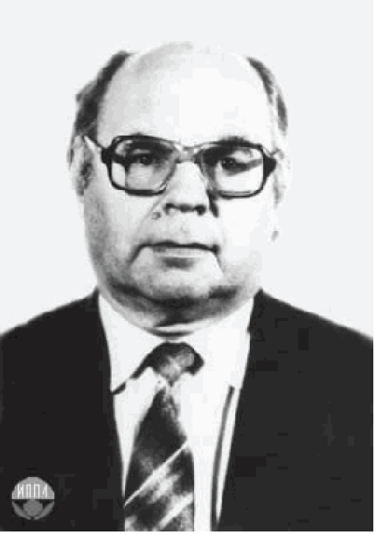
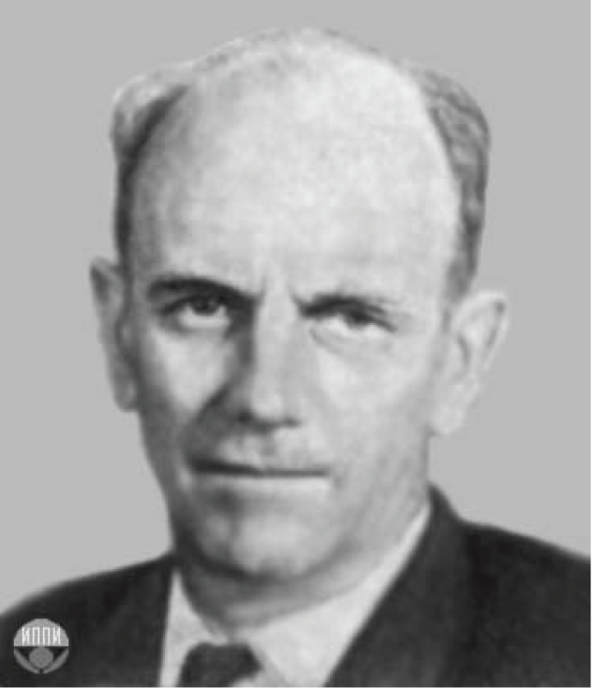
Critical Turbulence Length Scales

