Slide 1
Transfer of passive scalar variance in decaying grid turbulence with a mean scalar gradient
Luminita Danaila and Laurent Mydarski
CORIA, University of Rouen, France
McGill University, Montréal, Canada

Slide 2
Outline
I. Context and aim.
II. The real-space closure.
III. Conclusions and Perspectives.
2

Slide 3
I. Context. Energy transfer, in real space
FLOW
Re
Kolmogorov: Local isotropy
Universality
Real space:
A simple analytical platform: relationship between the second- and third-order moments at a scale r
→ energy flux at a scale r

Slide 4
I. Context
Kolmogorov 1941
Saffman 1968, Danaila et al. 1999, Lindborg 1999
Finite Reynolds numbers- flows:
Grid turbulence, round jet, channel flow (axis, near wall) ...
Conclusion:
Energy transferred at a scale r = turbulent advection + molecular effects+ large-scale effects: shear, decay, mean temperature gradient …

Slide 5
I. Context
Eq. (1)
Yaglom 1949; Danaila et al. 1999
Danaila and Mydlarski 2001
Real- Finite Reynolds numbers- flows: Slightly heated grid turbulence, grid turbulence with a mean scalar gradient
Energy transferred at a scale r → … large-scale effects
AIM: Use Eq. (1) as a predictive tool for S2
➔ Closure of the third-order term

Slide 6
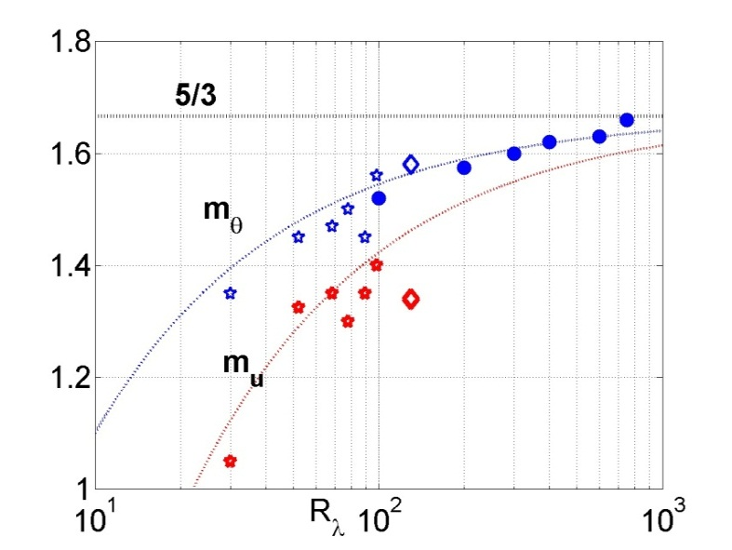
I. Closure of the nonlinear term in spectral space
with
Scenario:
For Pr=1
Danaila and Antonia, 2009
Batchelor 1959, Kraichnan 1971
Other expressions: Lumley 1975

Slide 7
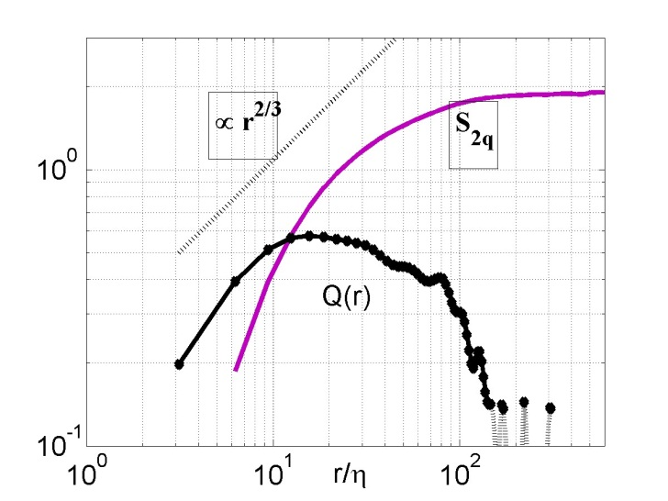
II. The closure in real space
1) The « energy » at a scale r, Q(r)
Danaila et al. 2012
Davidson 2007

Slide 8
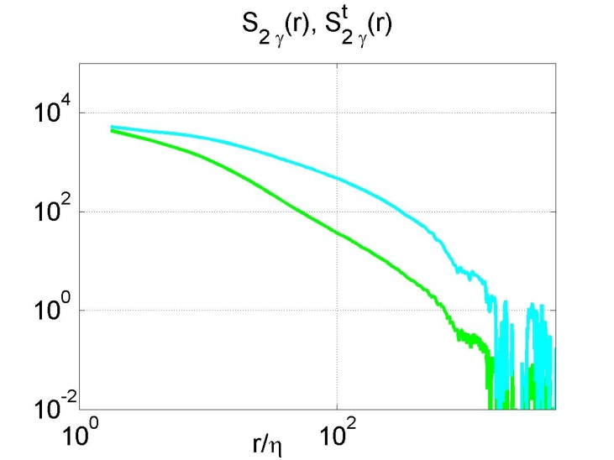
II. The closure in real space
2) The characteristic time at a scale r →
The intensity of the strain at a scale r= the 2nd order SF of the strain
The strain felt at a scale r from another, larger scale s = hypothesis of linearity
The number of larger scales which act upon the scale r

Slide 9
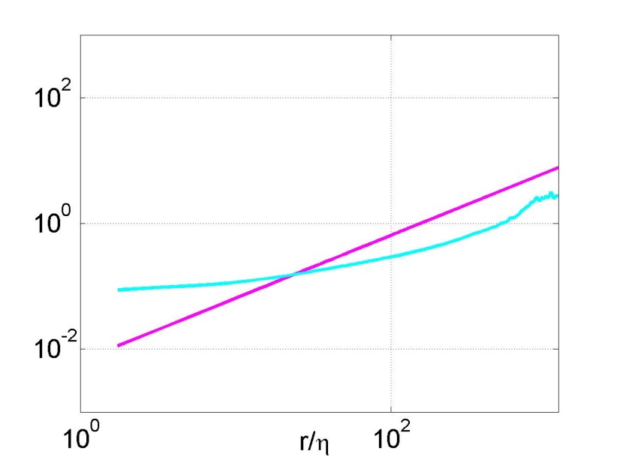
II. The closure in real space
The characteristic time at the scale r
Consistent with the ‘sweeping’ time for large r
Consistent with the Kolmogorov time
for small r

Slide 10
II. The closure in real space
Experimental results from (passive and) active grid turbulence with a mean scalar gradient
Mydlarski and Warhaft 1998
$$R_{λ}=[38, 582]$$

Slide 11
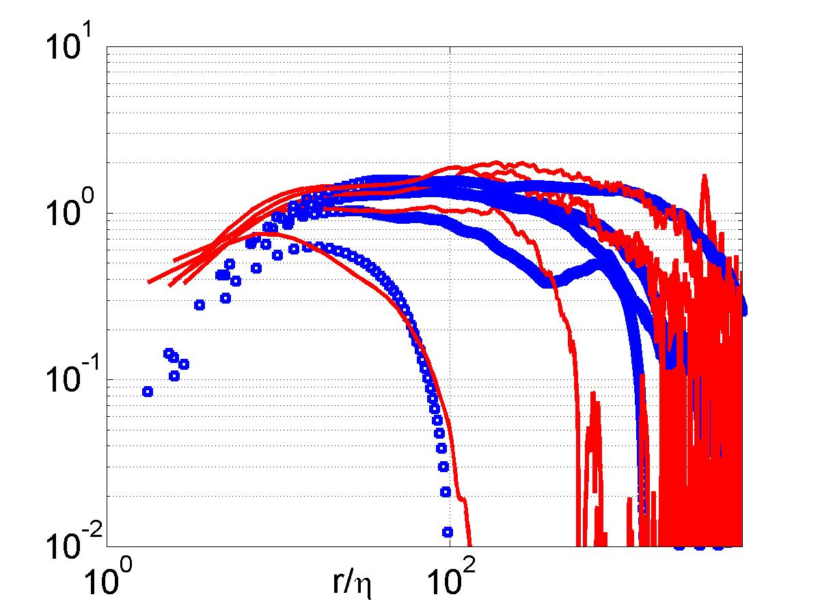
II. The closure in real space
$$R_{λ}=38$$
$$R_{λ}=140$$
$$R_{λ}=306$$
$$R_{λ}=407$$

Slide 12
III. Conclusions
A closure for the third-order term has been proposed and validated
Good agreement in active grid turbulence with a mean scalar gradient
The characteristic time used is calculated from the strain acting at each scale
The strain at each scale has contributions from the scale itself + a few larger eddies
Perspectives towards closures of the scale-by-scale energy budget equation analytically/numerically ➔ prediction of the scalar variance at each scale

